Slide 1
ASH: The Answer Set Programming based Hierarchical Abstraction Planner for Robots
RSMG 5
Oliver Michael Kamperis
Marco Castellani
Yongjing Wang

Slide 2
Background and Motivation
Planning requires reasoning about and making a series of related decisions regarding action and state change into an often large future temporal horizon prior to, or during, execution.
Classical “flat” planning is intractable for non-trivial problems;
Search space exponential in description size,
Number of solutions exponential in plan length.
In real-world, offline complete planning is non-feasible and futile.
Methods to overcome this include;
Specialise planners with application specific heuristics (manual or learnt),
Simplify or apply constraints to the problem that reduce search space,
Partial-plan online, split original problem into independently solvable sub-problems.
Notes:
Effectively, make a series of related decisions into the future that are intended to achieve some objective before starting to act.
The classic approach to planning is to simply generate a single “flat” sequence of actions that achieve the final objective. That is to generate a solution that solves the complete problem prior to execution, and then just blindly execute at run time.
However, this is intractable for most non-trivial problems because the search space usually grows exponentially in the size of the description of the planning domain, and because the number of possible paths increases exponentially with the plan length, there are many more possible combinations of decisions/actions to make (branches to explore) in a long plan.
It is too difficult to plan far into the future, and too likely the plan will fail.
Abstraction can provide both heuristic guidance and problem splitting
It is a human-like approach to reasoning, which accepts the fact that planning in the real world is non-feasible and futile, primarily because the real world is too complex and unpredictable in general
basically, the farther into the future we plan, the more like it is that the plan will fail, hence, we need to achieve online planning, the first step in solving this problem is to allow a planning problem to be split into smaller independently solvable parts which can be solved online, we use abstraction to enable this.
Otherwise problem complexity would be overwhelming
Accounting for all possibly contingencies usually impossible due to the volatility in the domain state and entropy in past observations

Slide 3
Planning over an Abstraction Hierarchy
The human approach to overcome complexity of real-world is to plan online by applying abstraction in reasoning;
Only decide upon the abstract stages of a plan initially,
Deal with the details of each stage as they occur,
If plan fails, only have to re-plan small portion of existing plan.
ASH has the following novel capabilities inspired by this;
Plan over a hierarchy of abstractions of a planning domain,
Abstract problems exponentially faster to solve,
Abstract solutions guide search in more concrete space,
Divide and sub-divide problem and solve each sub-problem independently,
Allows online partial planning but rarely leads to optimal plans,
Multiple types, standard propagation, or look-back propagation.
Notes:
Sub-divide the planning problem into distinct independently solvable sub-problems.
The proposed approach is intuitive, a planning problem is defined over multiple abstraction levels, arranged in a hierarchy.
Each level defines a distinct planning problem and only at the most abstract level does a complete plan have to be generated.
At every lower abstraction, the solution from the previous level is passed as a ``skeleton'' solution to the next.
This provides heuristic guidance to search and allows the planning problem to be split into distinct sub-problems.
These sub-problems allow the computation of partial plans which solve only a portion of the original problem, each of which can be found and returned independently.
This allows ASH to automatically split and solve even very long planning problems incrementally and online, with no additional knowledge required by the designer.
Fundamentally, this allows ASH to find reasonable quality solutions much faster than any solution could be found via ``flat'' planning.

Slide 4
Planning over an Abstraction Hierarchy
Planning domain it represented by multiple domain models at different abstraction levels, arranged in a hierarchy.
Iteratively solve the planning problems defined by the domain model at each abstraction is descending order.
Only at the most abstraction level does a complete plan have to be generated,
At lower abstractions, solution from the previous level is “skeleton” solution at the next, this provides guidance to search and allows problem splitting.
Skeleton solution is formed by effects of actions passed as sub-goals;
Sub-goals apply conformance constraint which limits number of solutions,
Constraint simply enforces that plans at all levels achieve the same effects,
Requires the ability to reason about state representation at different levels.
Notes:
a planning problem is defined over multiple abstraction levels, arranged in a hierarchy.Each level defines a distinct planning problem and only at the most abstract level does a complete plan have to be generated.At every lower abstraction, the solution from the previous level is passed as a ``skeleton'' solution to the next.This provides heuristic guidance to search and allows the planning problem
to be split into distinct sub-problems.These sub-problems allow the computation of partial plans which solve only a portion of the original problem, each of which can be found and returned independently.This allows ASH to automatically split and solve even very long planning problems incrementally and online, with no additional knowledge required by the designer.Fundamentally, this allows ASH to find reasonable quality solutions much faster than any solution could be found via ``flat'' planning.

Slide 5
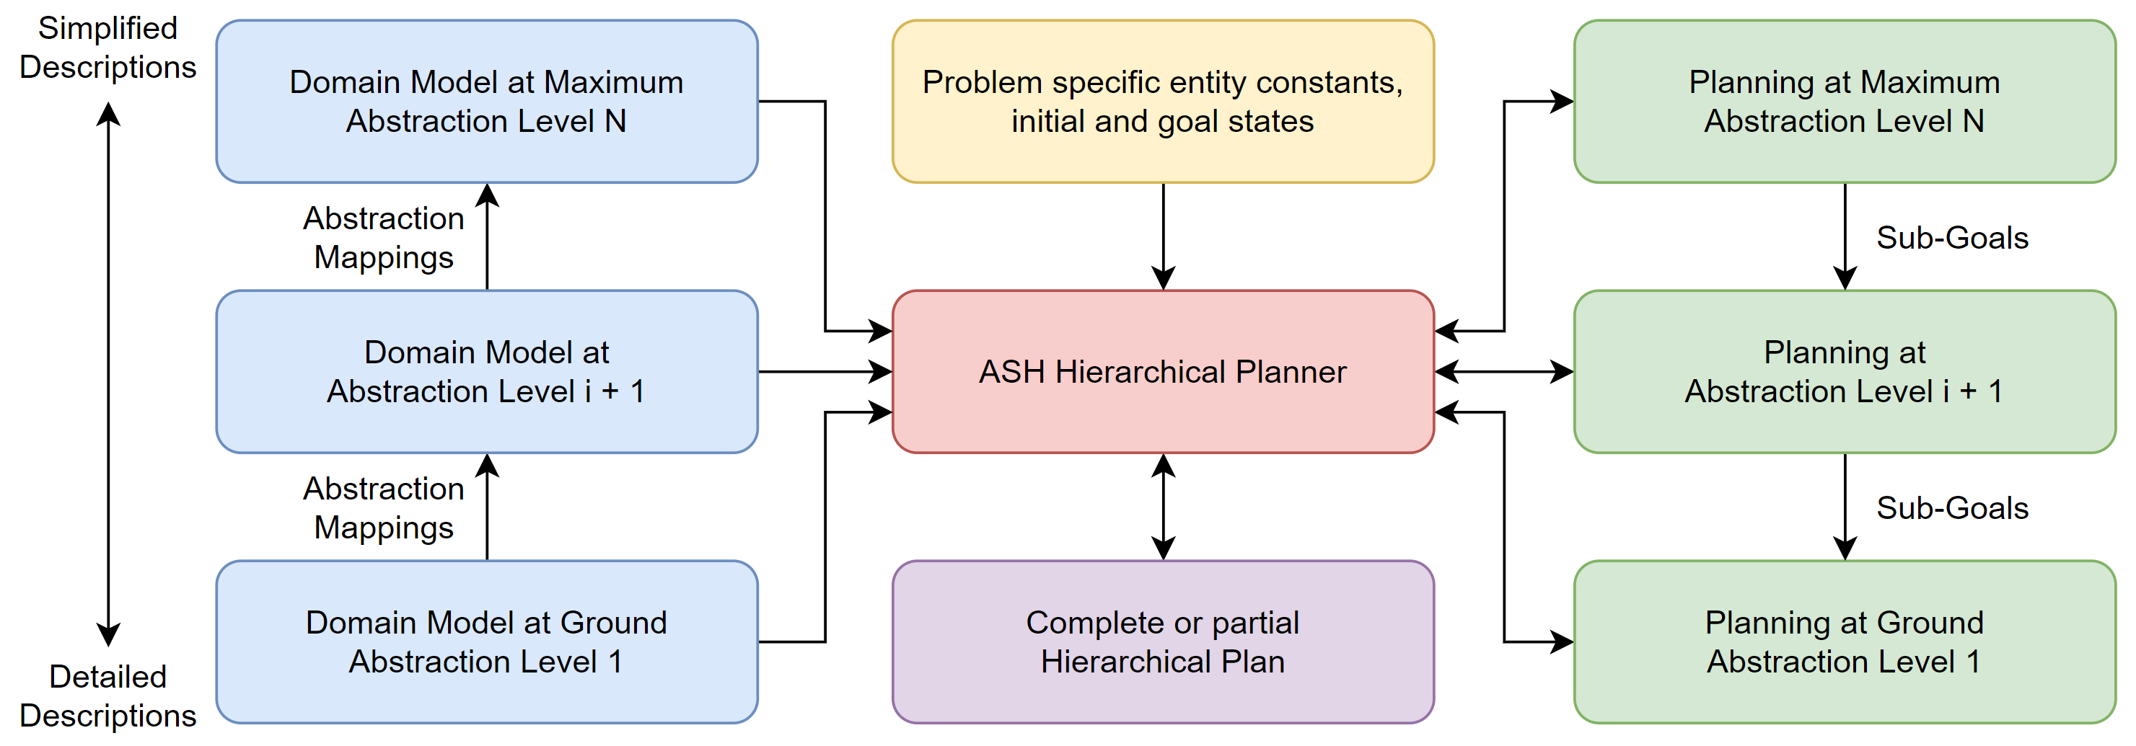
Planning over an Abstraction Hierarchy
Design sufficiently expressive ground model to deal with the application.
Abstractions are then created through various methods.
Abstraction mappings define relationship between state over abstractions.
Notes:
Creating abstractions is about deciding which parts of the problem can be considered details and safely abstracted away.
A meaningful abstraction should significantly reduce problem complexity that maps in a well defined manner to the concrete.

Slide 6
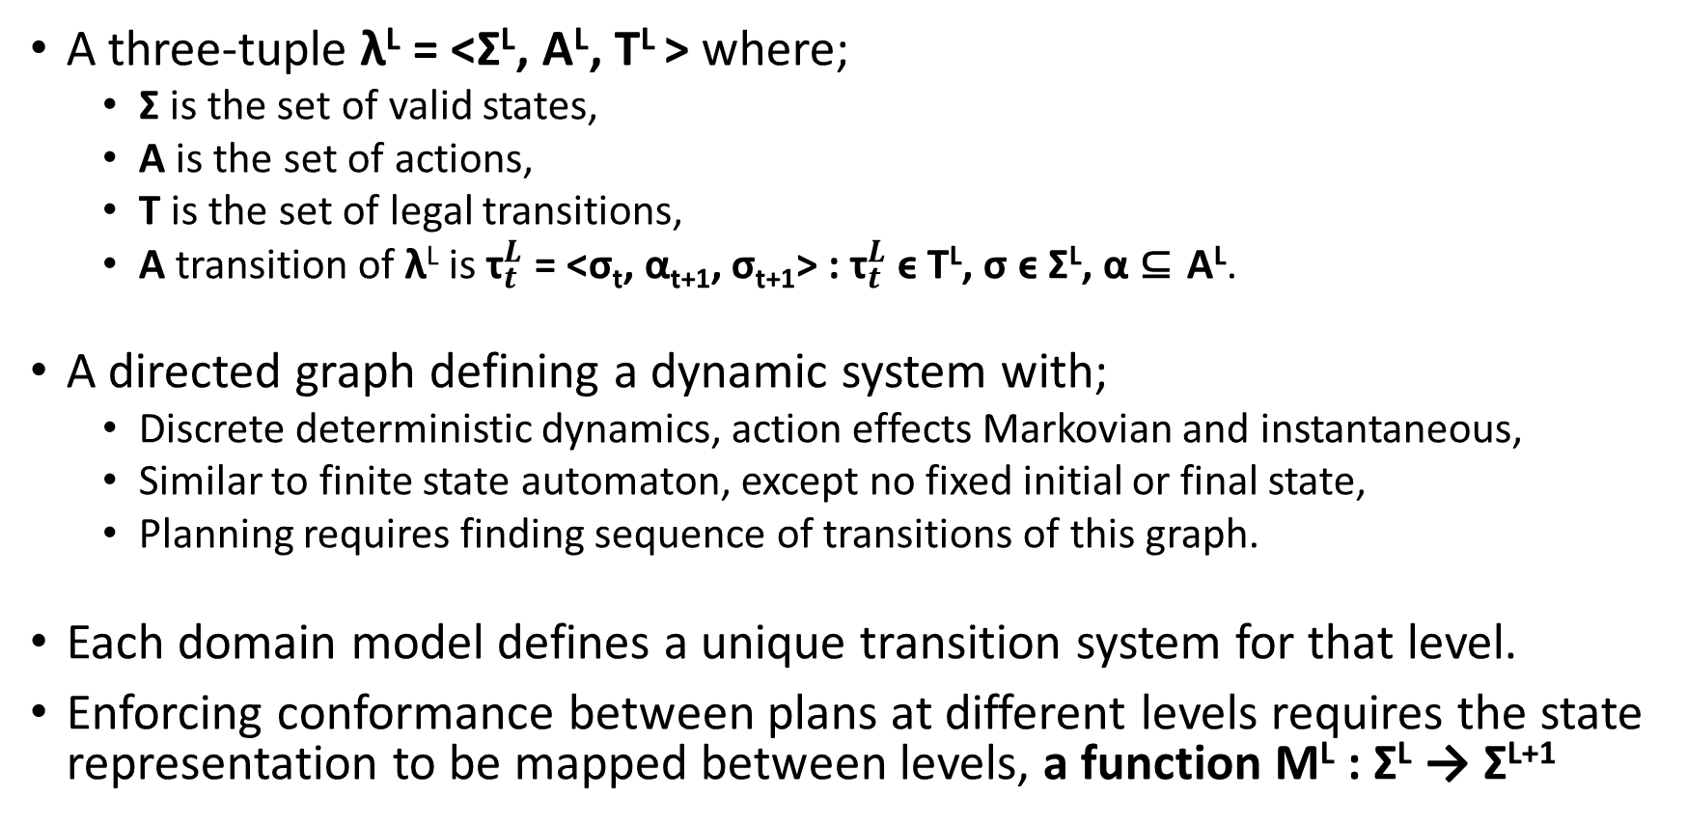
State Transition Systems
A three-tuple λ^{L} = <Σ^{L}, A^{L}, T^{L} > where;
Σ is the set of valid states,
A is the set of actions,
T is the set of legal transitions,
A transition of λ^{L} is ${\text{τ}}_{t}^{L}$ = <σ_{t}, α_{t+1}, σ_{t+1}> : ${\text{τ}}_{t}^{L}$ ϵ T^{L}, σ ϵ Σ^{L}, α ⊆ A^{L}.
A directed graph defining a dynamic system with;
Discrete deterministic dynamics, action effects Markovian and instantaneous,
Similar to finite state automaton, except no fixed initial or final state,
Planning requires finding sequence of transitions of this graph.
Each domain model defines a unique transition system for that level.
Enforcing conformance between plans at different levels requires the state representation to be mapped between levels, a function M^{L} : Σ^{L} → Σ^{L+1}

Slide 7
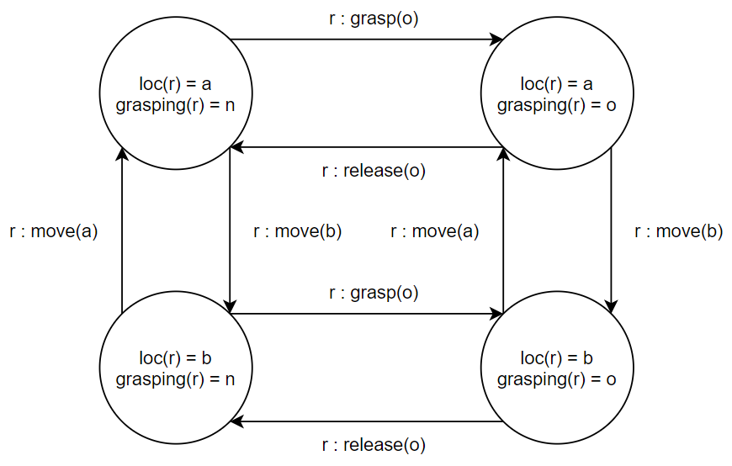
State Transition Systems
Systems are defined under answer-set semantics.
Each state and transition is unique answer set of program Π containing;
The domain independent part of ASH,
The domain dependent planning domain model, and…
A valid state is unique answer set of Π plus encoding of a complete set of state variables.
A legal transition is unique answer of Π plus an arbitrarily large set of concurrent actions.
Notes:
There can only be one possible interpretation of a state given a complete set of state variables, if only a sub-set of state variables is given then there may be multiple possible interpretations, since there many be multiple valid states that include that sub-set of assigned variables.
There can only be one resulting state from a state transition.

Slide 8
Reductions
Simplest type of abstraction, based on assumptive reasoning;
Obtained by removing a condition prohibiting or penalising an action,
Assume the condition can be met by a sequence of actions at the next level,
Adds or reduces cost of arcs in a state transition system,
Result is large reduction in solution length.
Reductions are well defined and have the upward-solution property;
Existence of concrete solution implies existence of abstract solution,
This is because concrete solution is also solution to the abstract problem.
State space is identical, so state mapping is direct and one-to-one;
in^{L+1}(object) = location ← in^{L}(object) = location
Notes:
Obtained by an action precondition deletion process.
Example: travel to the fuel station, move to road A, to road B, to road C, pull into fuel station, we simply assume that there is some path (sequence of actions) which achieve the same effect as the single action

Slide 9
Refinements
More complex, based on “ancestry” relations between classes and entities;
Obtained by relating entities to their components and removing a class type,
Based on concepts of resolution and granularity in explanation,
Reduces the number of entity constants and state space of transition diagram,
Result is large reduction in state space and solution length.
Refinements also well defined and have the downward-solution property;
Existence of abstract solution implies existence of concrete solution,
This is because concrete solution is also solution to the abstract problem.
State space reduces, so state mapping is direct but many-to-one;
in^{L+1}(object) = location₁ ← in^{L}(object) = location₂, desce_of(l, location₁, location₂)
State of refined model seen as the union of the non-refined states that map to it.
Notes:
Type of abstraction based on analogy and the concepts of resolution and granularity of the representations of a dynamic domain, is this much detail needed in the description of the domain.
For example, a room is the ancestor of the cells that make it up, we can describe an object as being in either
A state of a refined model can be seen as the union of the non-refined states that map to it.
A room and a cell are both locations that object can be located in,
A cell is a specific location within a room,
To express this we simply say that the cell is the child of the room,
In a refinement we may delete the cell class, and thus the room obtains the location type from cell.

Slide 10
Redefinitions
No limits, anything goes!
Removal or replacement of state variables,
Replacement of actions with abstract task descriptions.
Not so well defined, no clear general way to define the mapping between levels, needs to be designed carefully by the engineer.
Intended only at the highest level for abstract task scheduling;
Determine a sequence of high-level tasks that need to be completed,
Each task is itself its own planning problem.
Redefinitions are difficult but potentially very powerful due to the ability to form task schedules form abstract goal descriptions.
Notes:
Sub-divide the planning problem into distinct independently solvable sub-problems

Slide 11
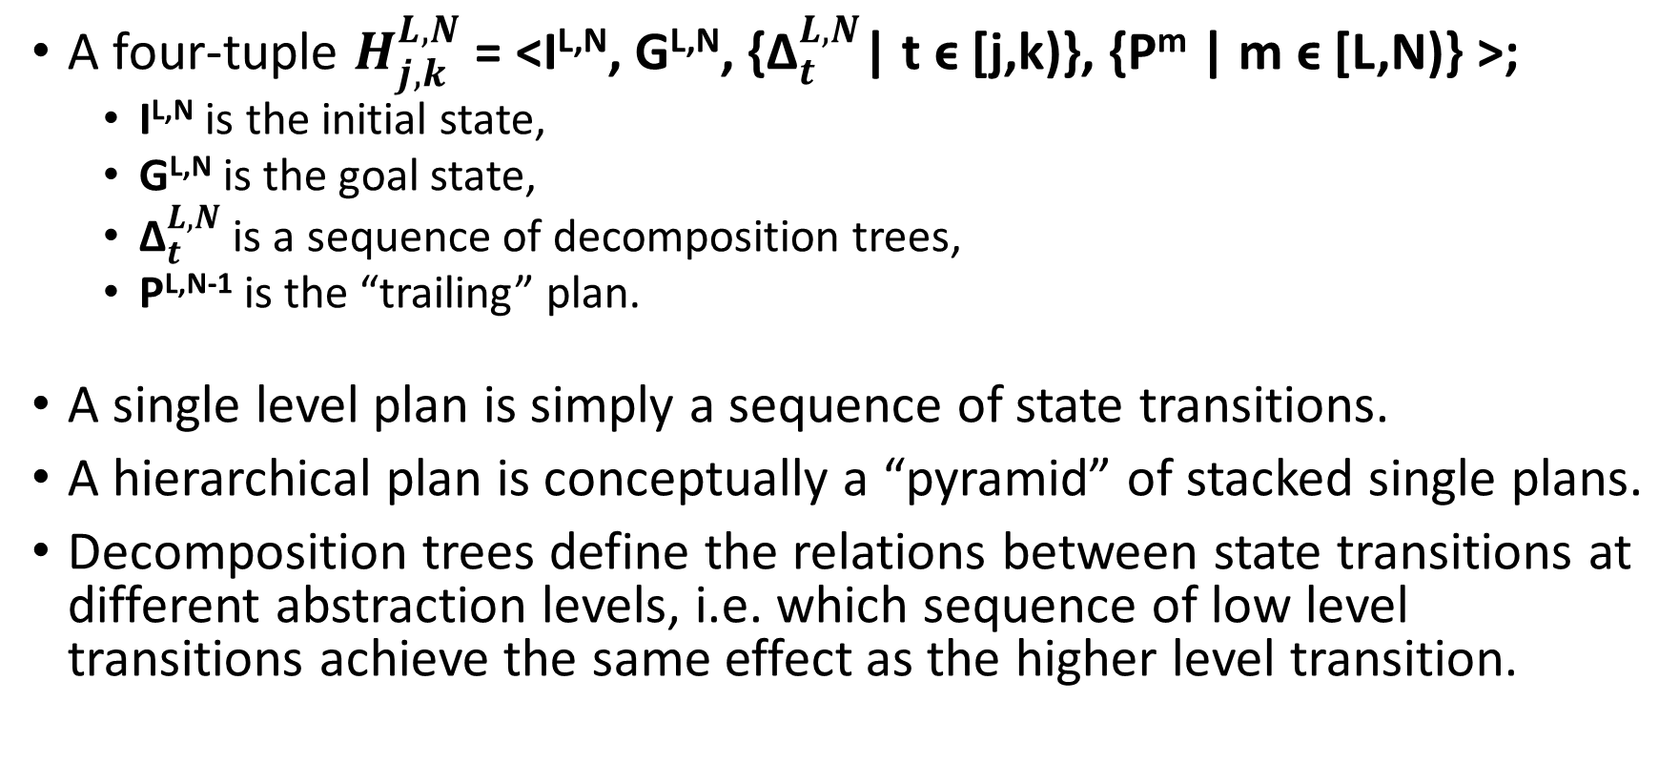
Hierarchical Plans
A four-tuple $H_{j,k}^{L,N}$ = <I^{L,N}, G^{L,N}, {${\text{Δ}}_{t}^{L,N}$| t ϵ [j,k)}, {P^{m} | m ϵ [L,N)} >;
I^{L,N} is the initial state,
G^{L,N} is the goal state,
${\text{Δ}}_{t}^{L,N}$ is a sequence of decomposition trees,
P^{L,N-1} is the “trailing” plan.
A single level plan is simply a sequence of state transitions.
A hierarchical plan is conceptually a “pyramid” of stacked single plans.
Decomposition trees define the relations between state transitions at different abstraction levels, i.e. which sequence of low level transitions achieve the same effect as the higher level transition.

Slide 12
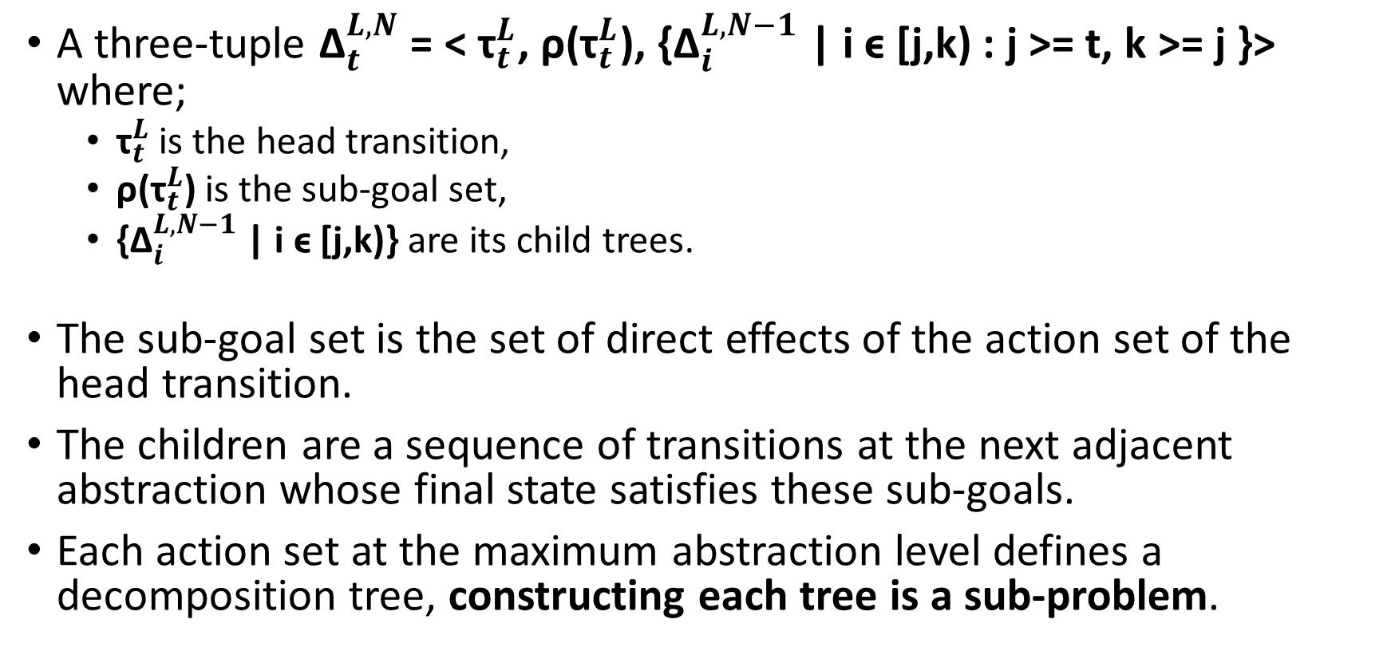
Decomposition Trees
A three-tuple ${\text{Δ}}_{t}^{L,N}$ = < ${\text{τ}}_{t}^{L}$, ρ(${\text{τ}}_{t}^{L}$), {${\text{Δ}}_{i}^{L,N−1}$ | i ϵ [j,k) : j >= t, k >= j }> where;
${\text{τ}}_{t}^{L}$ is the head transition,
ρ(${\text{τ}}_{t}^{L}$) is the sub-goal set,
{${\text{Δ}}_{i}^{L,N−1}$ | i ϵ [j,k)} are its child trees.
The sub-goal set is the set of direct effects of the action set of the head transition.
The children are a sequence of transitions at the next adjacent abstraction whose final state satisfies these sub-goals.
Each action set at the maximum abstraction level defines a decomposition tree, constructing each tree is a sub-problem.

Slide 13
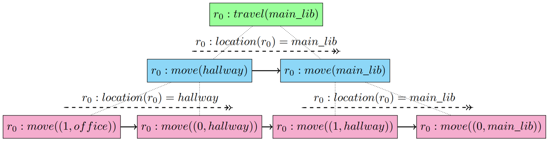
Decomposition Trees
Each node is the head of its own tree.
Tree is complete if it is either at the ground level or is conformant.
Tree is absolute if is complete and all of its children are absolute.
Each tree is independently solvable.

Slide 14
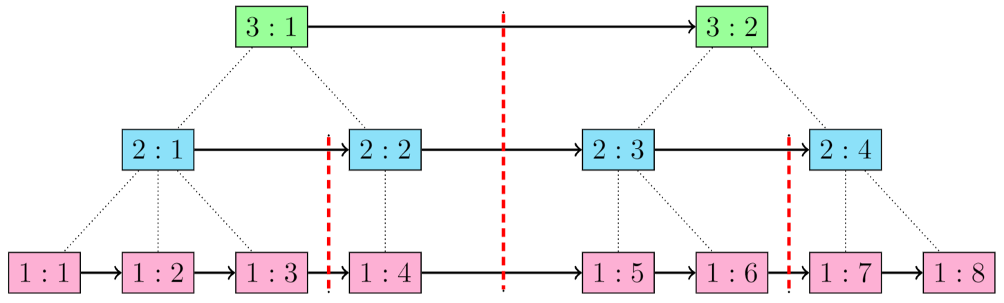
Decomposition Trees in Hierarchical Plans
Nodes are of the form [ abstraction level : time step ].
Red lines are possible divisions or sub-divisions;
Each division is a tree or sequence of trees,
Divisions are solved iteratively from left to right.
Notes:
You can solve all the trees or you can solve any sub-set of the trees, starting from the left most unsolved tree.

Slide 15
Problems Encountered
Where do we choose to divide a hierarchical plan?
Do we allow revision of previously completed trees?
If so how many do we allow to be revised?
Complexity of constructed tree not indicative of complexity of solving it.
Notes:
You can solve all the trees or you can solve any sub-set of the trees, starting from the left most unsolved tree.
Many possible divisions but not currently a way to determine what chooses are “good”.
Lower numbers of trees is easier and faster to solve but leads to lower optimality because smaller future outlook leads to “undoing”.
Trees are rarely balanced, different numbers of child nodes.

